Slide 1
VPP Regional Parking Project
Workshop
April 3rd, 2015

Slide 2
Introduction
The Value Pricing Pilot (VPP) Parking Pricing Regional Analysis Project will analyze regional parking policy approaches and develop and demonstrate local parking strategies, using a new regional parking database. This project builds on a decade of parking policy analysis work at MTC, including both support for local planning efforts and development of supportive regional policies. This project is a two year regional initiative led by the Metropolitan Transportation Commission (MTC), made possible by a grant from the Federal Highway Administration (FHWA) through the Value Pricing Pilot (VPP) Program. Participation is invited from local jurisdictions, transit agencies, Caltrans, ABAG, CMAs, development, business and community stakeholders, and other interested parties.

Slide 3
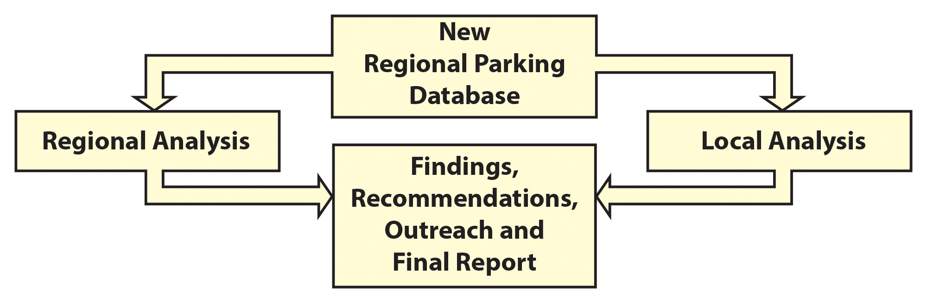
Project Overview
Database
Data collection for 25 cities
Standardizing data collection process
Centralizing data storage
Improving regional analysis
Policy Research
Compiling relevant research applications in the Bay Area
Analyzing methods for enacting parking pricing policies

Slide 4
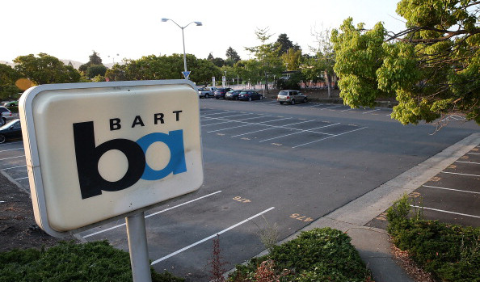
Presentation Overview
Part 1: Data & Visualization
Data collection and database
Website & data visualization
Interpreting data visualizations
Part 2: Policy Analysis
Method of analysis
Research & Findings
Potential Policy Actions
Next Steps

Slide 5
Data Collection

Slide 6
Data Collected
Legacy Data (14 Sites)
VPP Data (25 Sites)
1 | Los Altos Downtown
2 | Berkeley - Downtown
3 | Berkeley - Telegraph
4 | Berkeley - Elmwood
5 | Walnut Creek Downtown
6 | San Carlos Downtown
7 | Concord Todos Santos Plaza
8 | Oakland - Montclair
9 | Mountain View
10 | Redwood City Downtown
11 | San Leandro Downtown and BART Station Area
12 | Oakland Jack London Square
13 | San Mateo Downtown
14 | Oakland Temescal District
Alameda Park Street Downtown District
Pinole San Pablo Avenue
Burlingame Caltrain Station Area
Union City Downtown and BART Station Area
Sunnyvale Downtown and Caltrain Station Area
Lafayette Mt Diablo Boulevard and BART Station Area
Dublin BART Station Area and Dublin Boulevard
San Jose N Downtown
San Jose NE Downtown
San Jose S Downtown
San Jose Diridon Station Area
El Cerrito del Norte BART Station Area
El Cerrito Plaza BART Station Area
Millbrae El Camino Real and Station Area
Martinez Downtown and Amtrak Station Area
Gilroy Downtown and Station Area
Emeryville Shopping District
Fairfield Downtown and Amtrak Station Area
Hayward Downtown and BART Station Area
Santa Rosa Downtown, Railroad Square, and Surrounding Areas
Sausalito Waterfront
South San Francisco Downtown
Vallejo Downtown and Waterfront
Albany Solano Avenue
Albany San Pablo Avenue

Slide 7
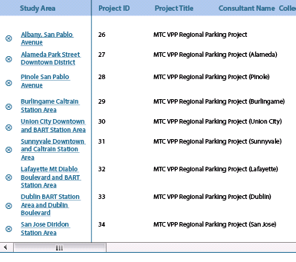
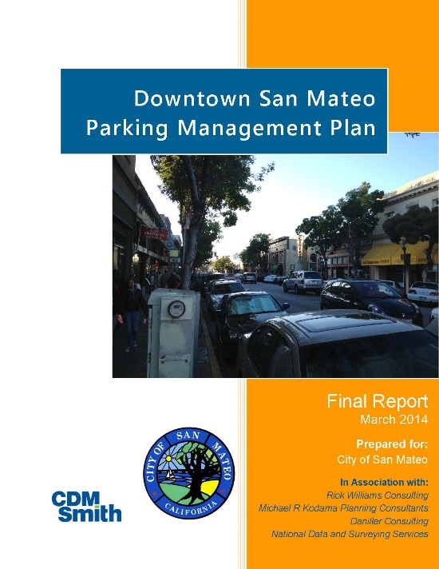
Database Format
Standardizes data format, centralizes storage
Consistency across data collections – allows for comparison between cities & between dates
Flexibility to incorporate any city’s parking
Block-level and Facility-level
Quickly find old studies

Slide 8
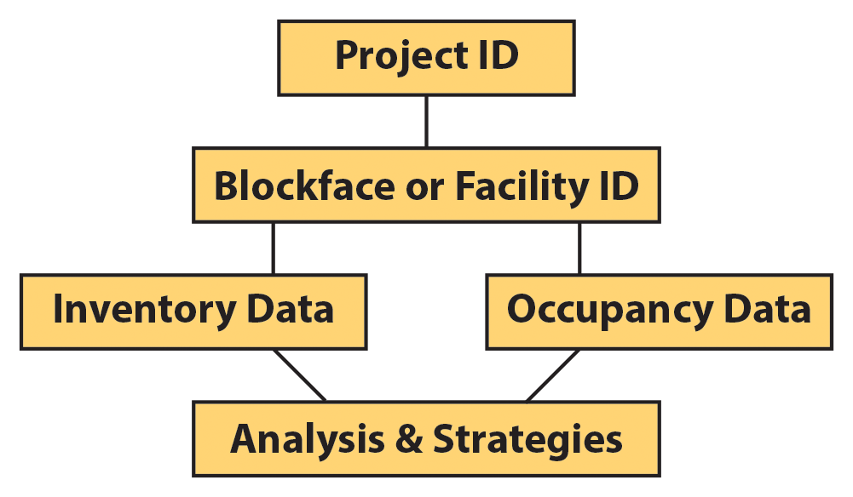
Database Format

Slide 9
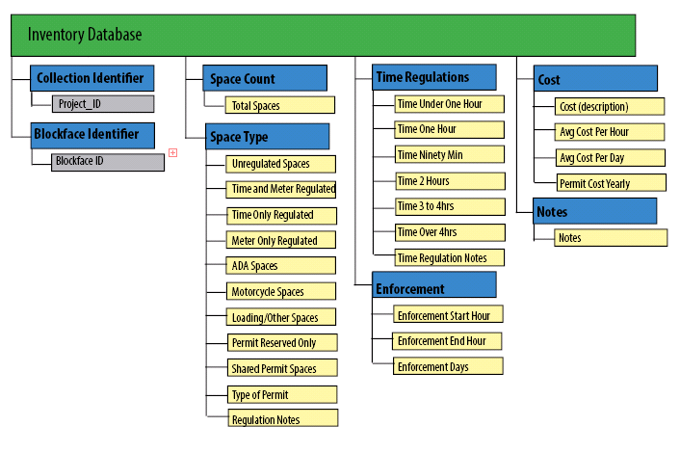
Database Format - Inventory

Slide 10
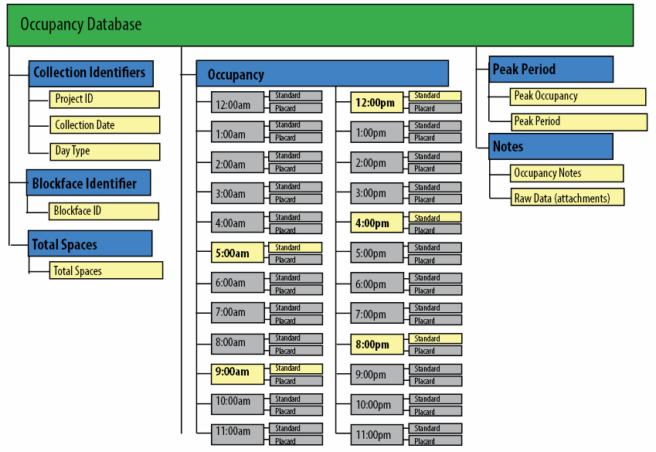
Database Format - Occupancy

Slide 11

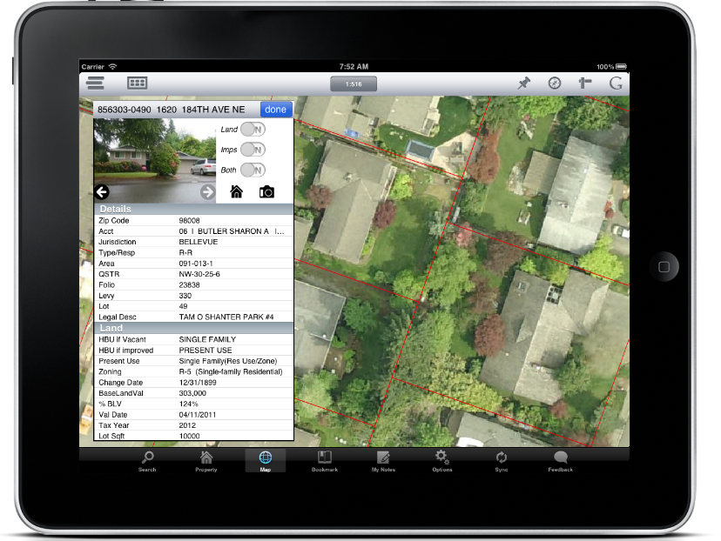
Web Application
Automate data-to-mapping process
Reduce cost and time of data collection
Reduce error in data input
Currently testing in field

Slide 12
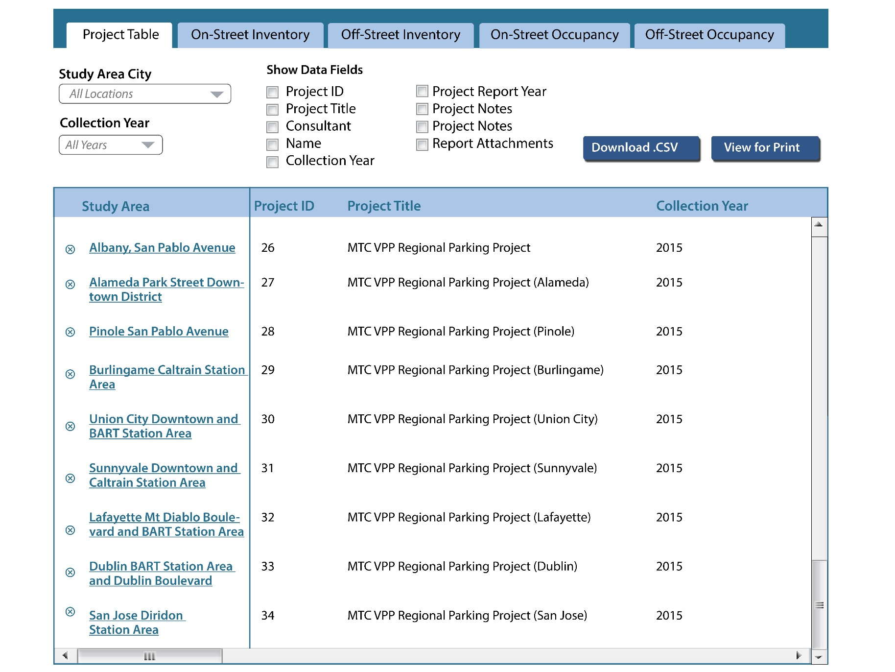
Web-based Database Visualization
z

Slide 13
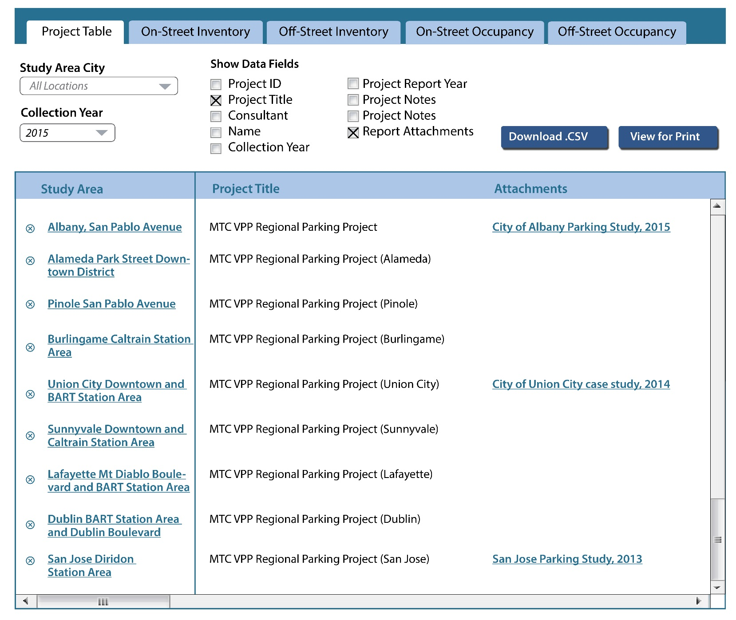
Web-based Database Visualization

Slide 14
Data Visualization

Slide 15
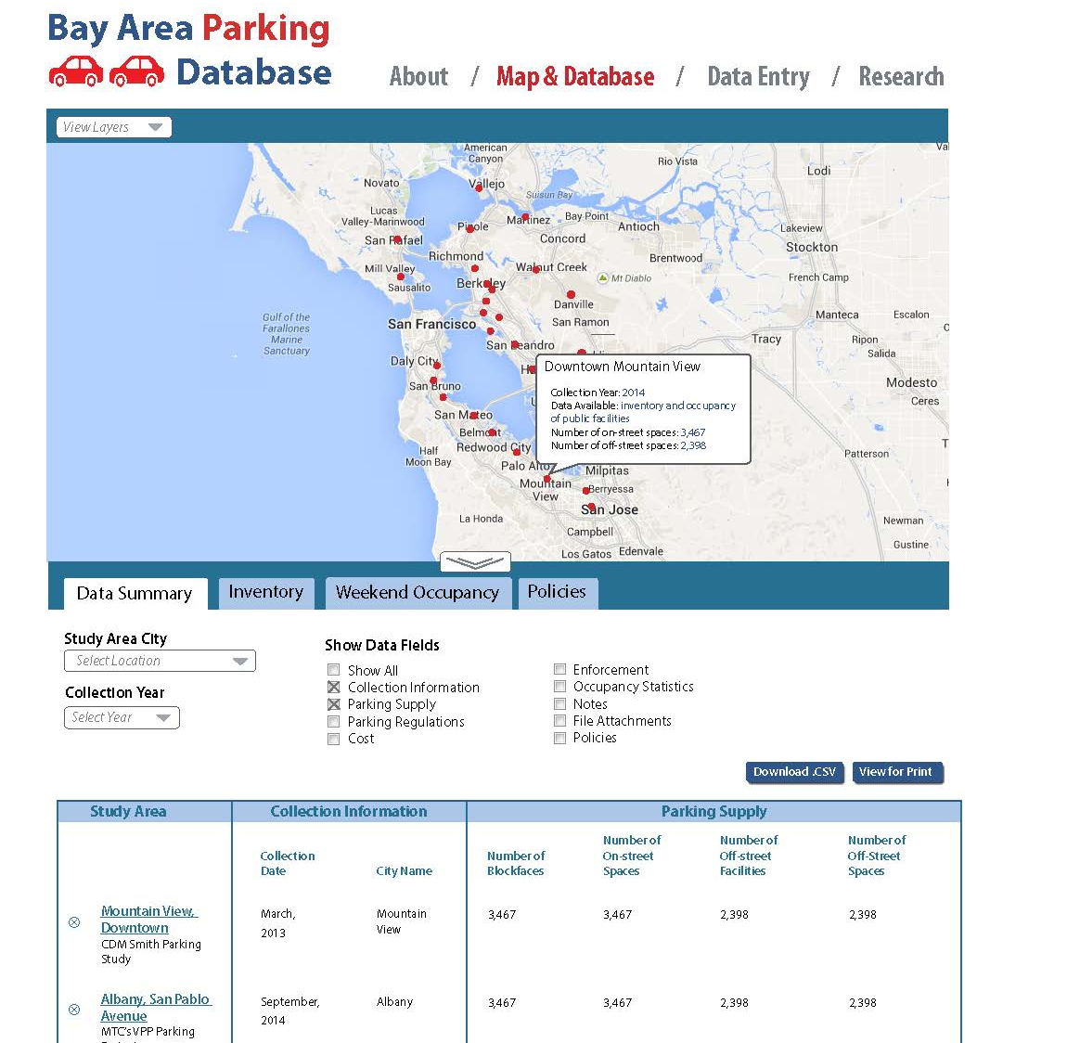

Slide 16
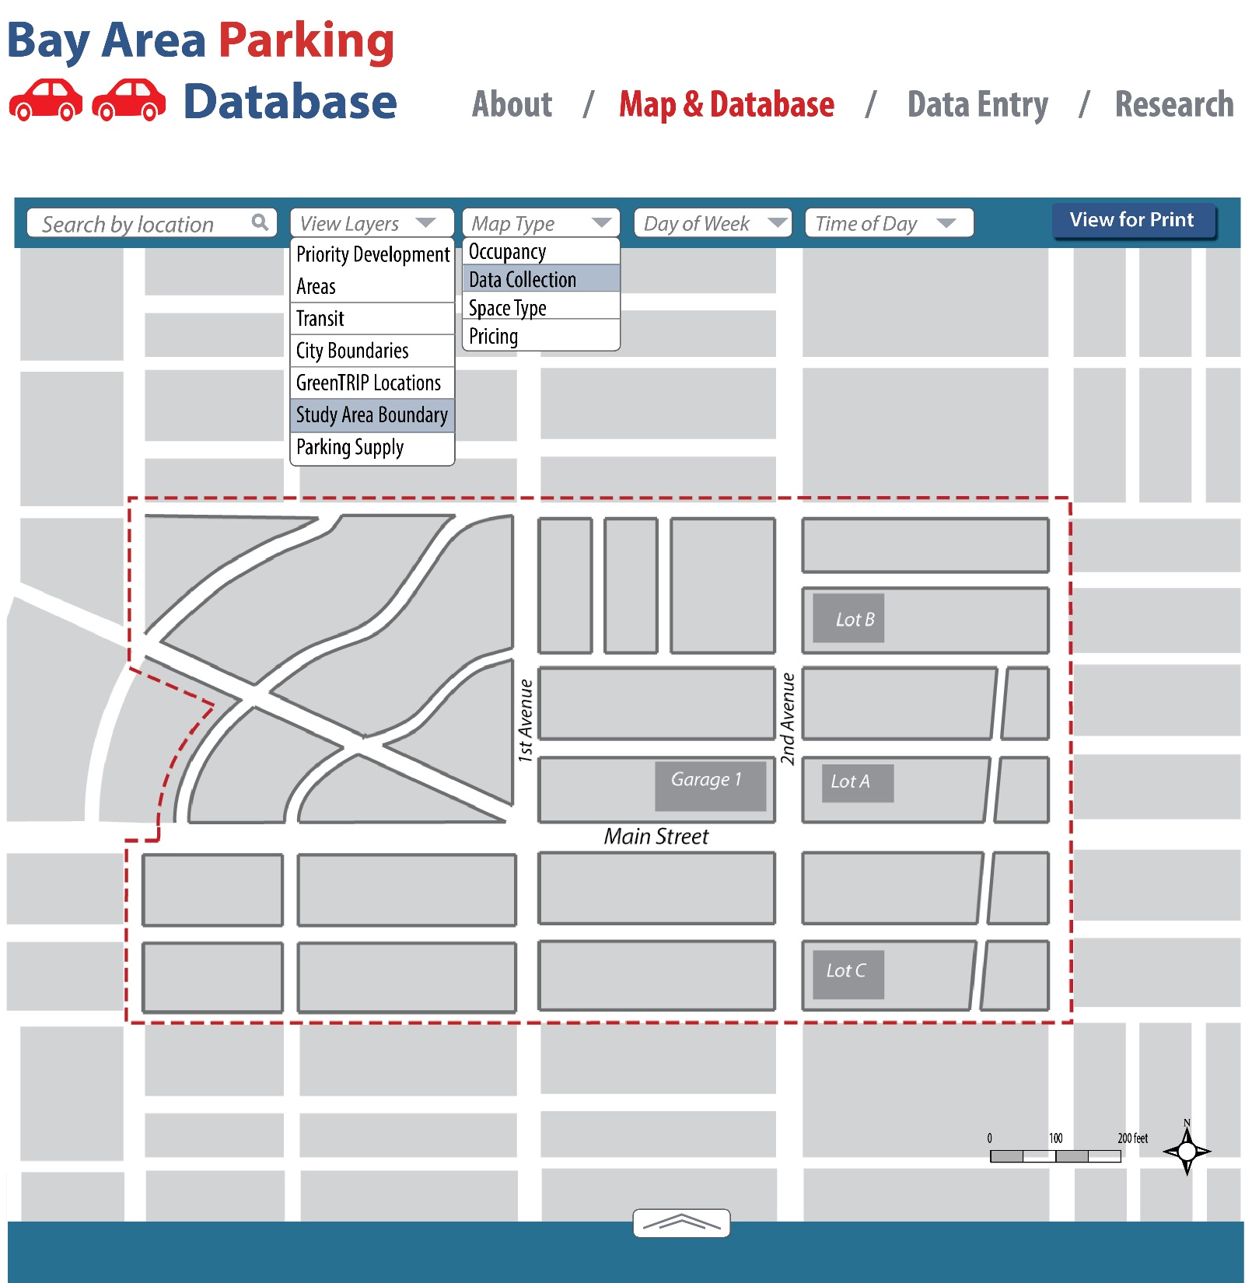

Slide 17
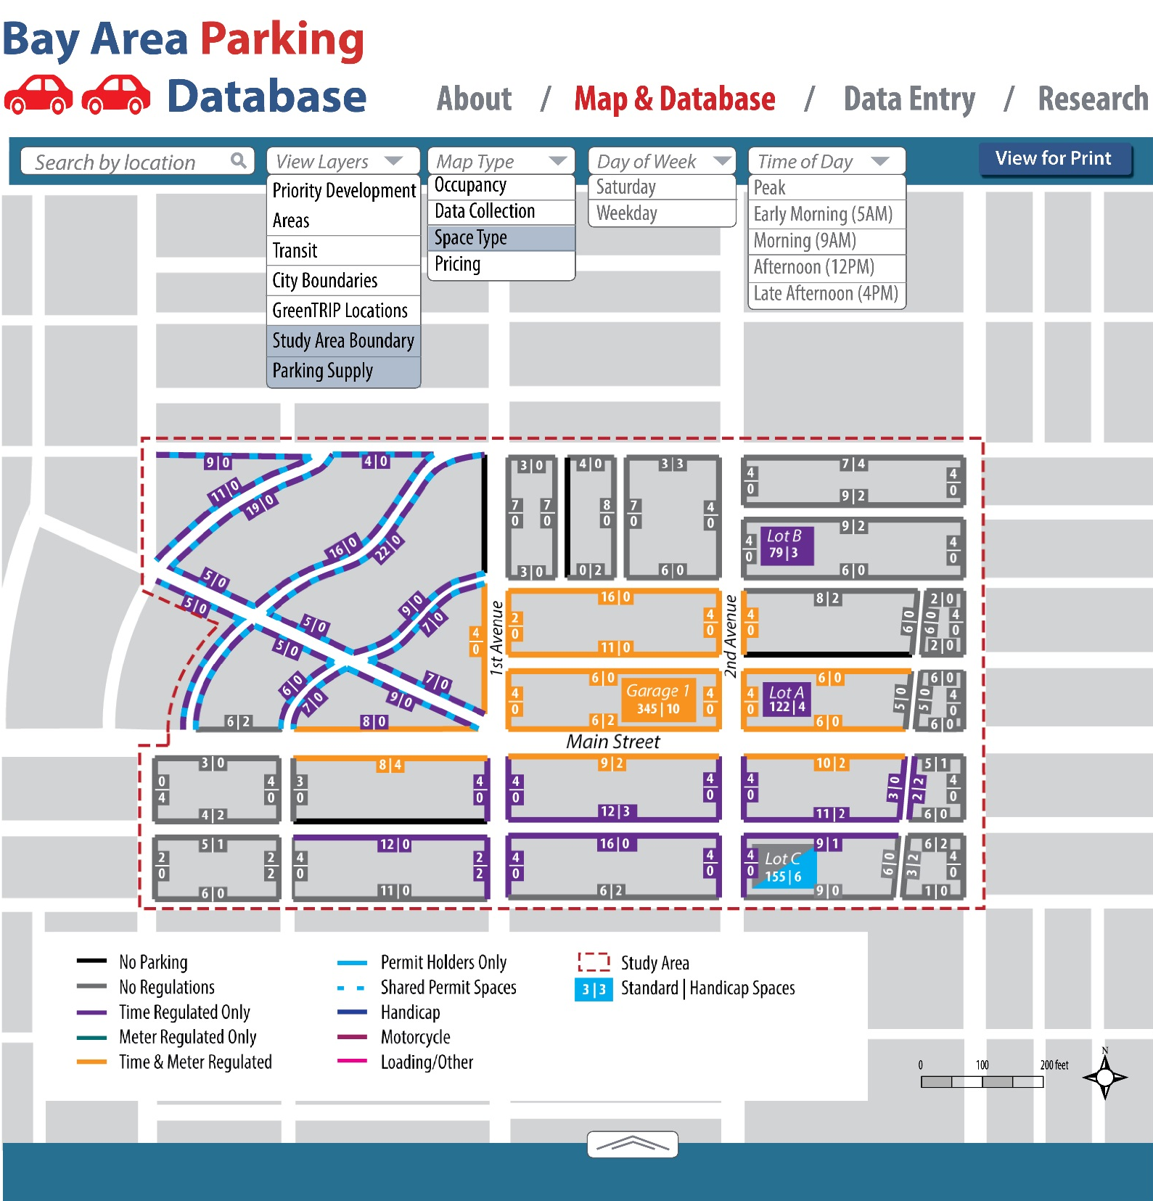

Slide 18
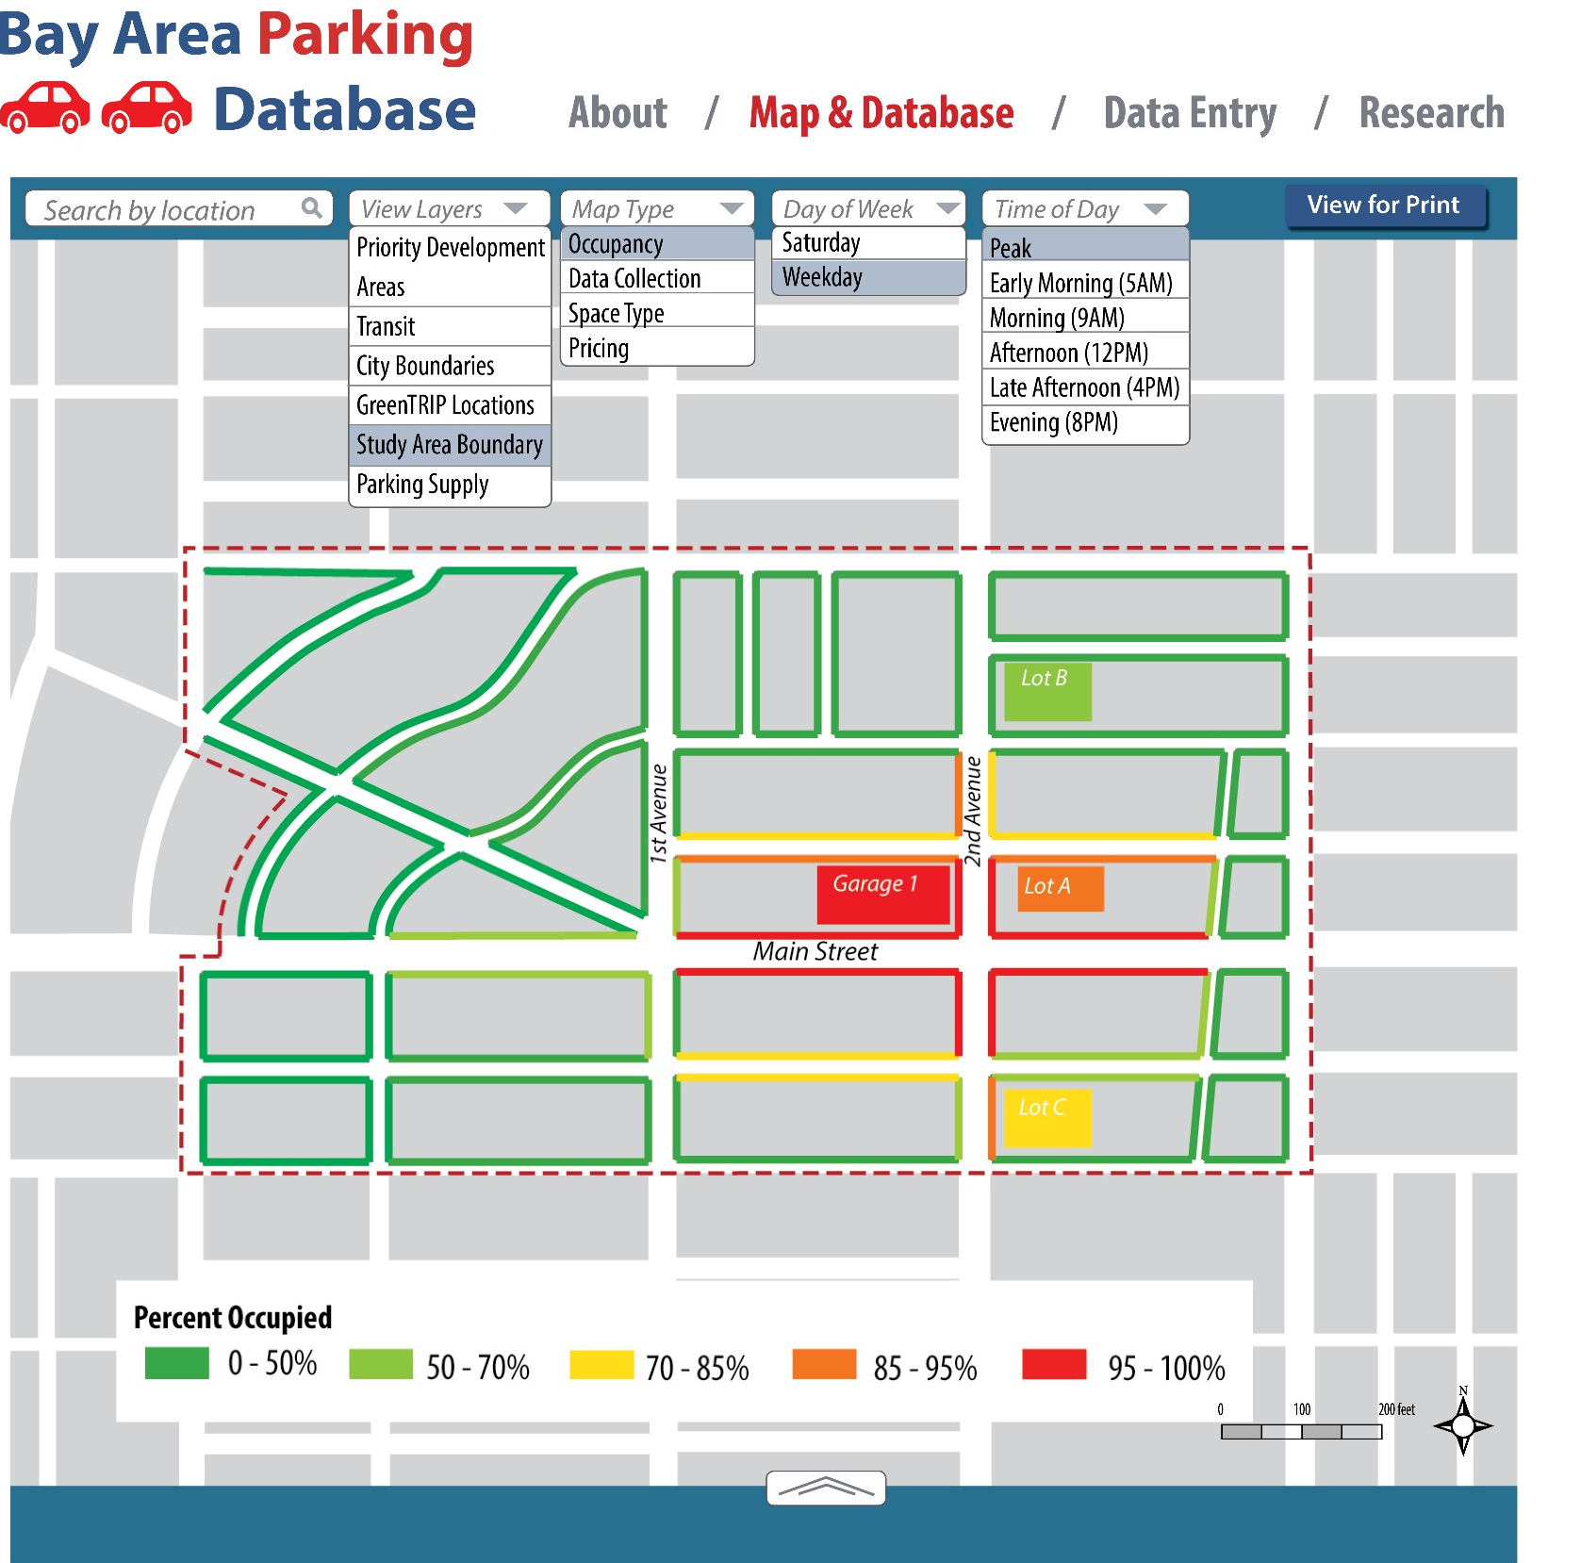

Slide 19
Database Summary
Benefits of visualizations and database
Understanding of issues based on real world data
Download and analyze data directly
Use data visualizations to begin policy conversations
Use data visualizations to support change in policies
Use visualizations to understand needs for a parking study or policy implementation plan

Slide 20
Database and Data Visualizations
Standardization - improves ability to make comparisons, improves use of “lessons learned” approach
Streamline process time, and costs: automate calculations & analysis, increases transparency, reduces error
Improve local understanding of very local patterns, leading to development of appropriate strategies, e.g., pricing, access to less used parking, multi-modal access improvements, wayfinding, employee programs, etc
Improve regional understanding of patterns

Slide 21
Discussion Database/Data Visualization

Slide 22
Interpreting Thematic Maps

Slide 23
Thematic Maps
Is supply underutilized or overutilized?
Occupancy
On-street 36%
Off-street 29%
Total 31%
Occupancy
On-street 86%
Off-street 91%
Total 90%

Slide 24
Thematic Maps
2. What is the peak period?
3. On-street vs. off-street

Slide 25
Thematic Maps
4. Are there hot spots? Or specific patterns?

Slide 26
Thematic Maps
5. How does occupancy correlate with regulations?

Slide 27
Thematic Maps
Do current regulations and prices support desired occupancy patterns (e.g., 85% performance goal), or do current pricing/regulations (of lack thereof) create problems in some places, at some times?

Slide 28
Translating observations to policies
Observation/
Identification
Develop Goals/ Approach
Develop Strategies/ Policies

Slide 29
Translating observations to policies
Observation / Finding
High usage throughout several blocks of on-street parking areas (e.g., Main Street), but low usage of off-street areas
Strategy
Coordinate on-street and off-street pricing (i.e., price on-street higher than off-street) and improve wayfinding
Develop Goals
Distribute parking usage more evenly

Slide 30
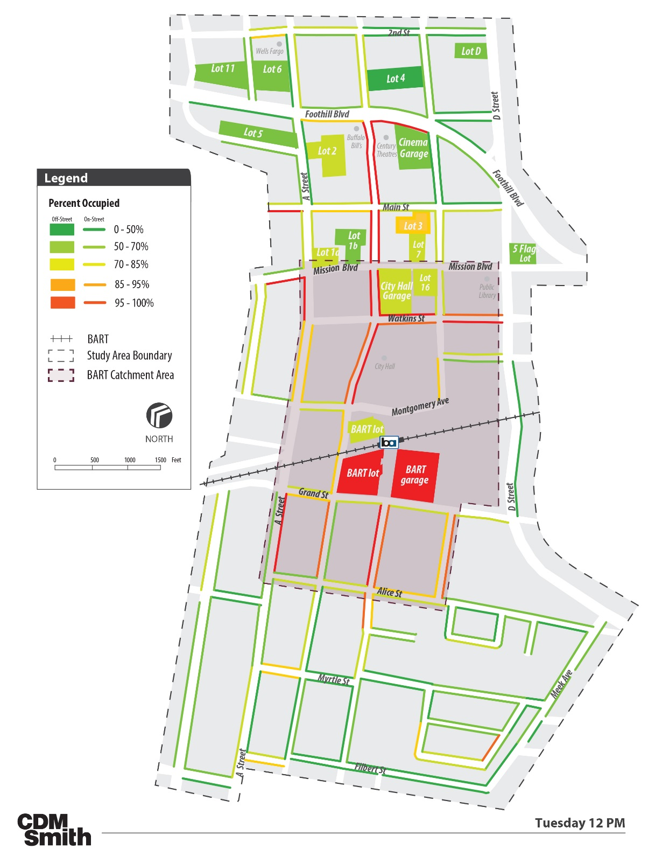
Application – City of Hayward
Peak period
Corridor
Total supply
On-street vs off-street
Hot spot areas
Patterns
Regulations
Enforcement

Slide 31
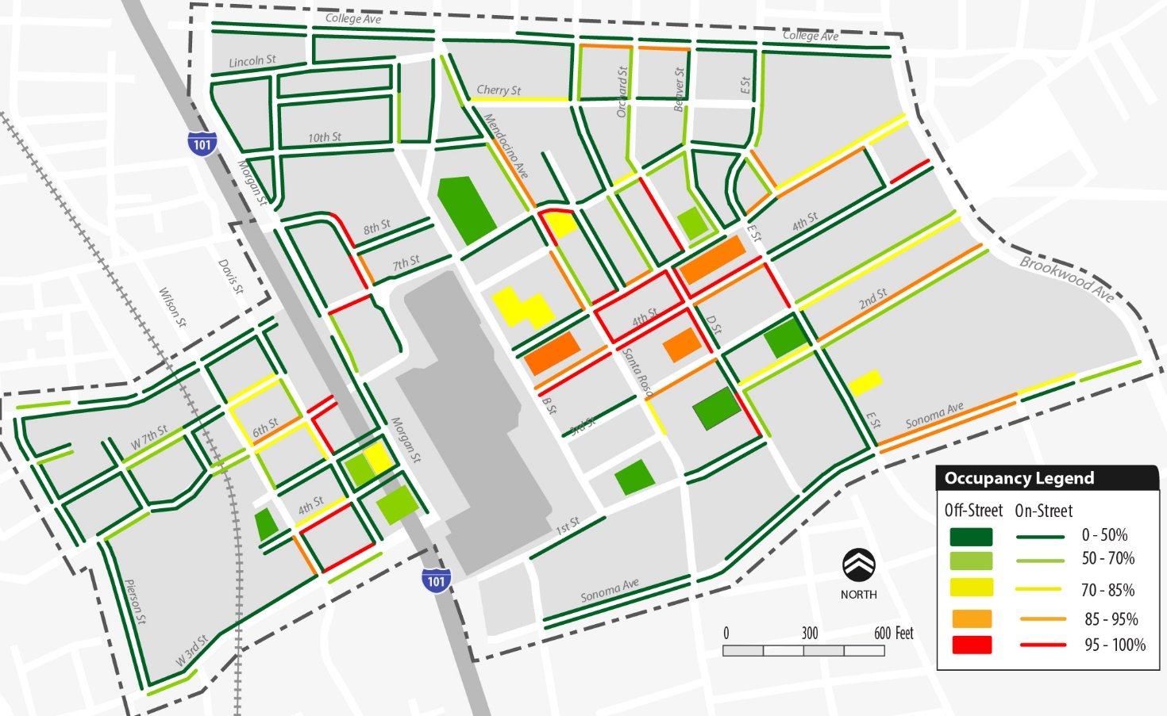
Application – City of Santa Rosa

Slide 32
Questions?

Slide 33
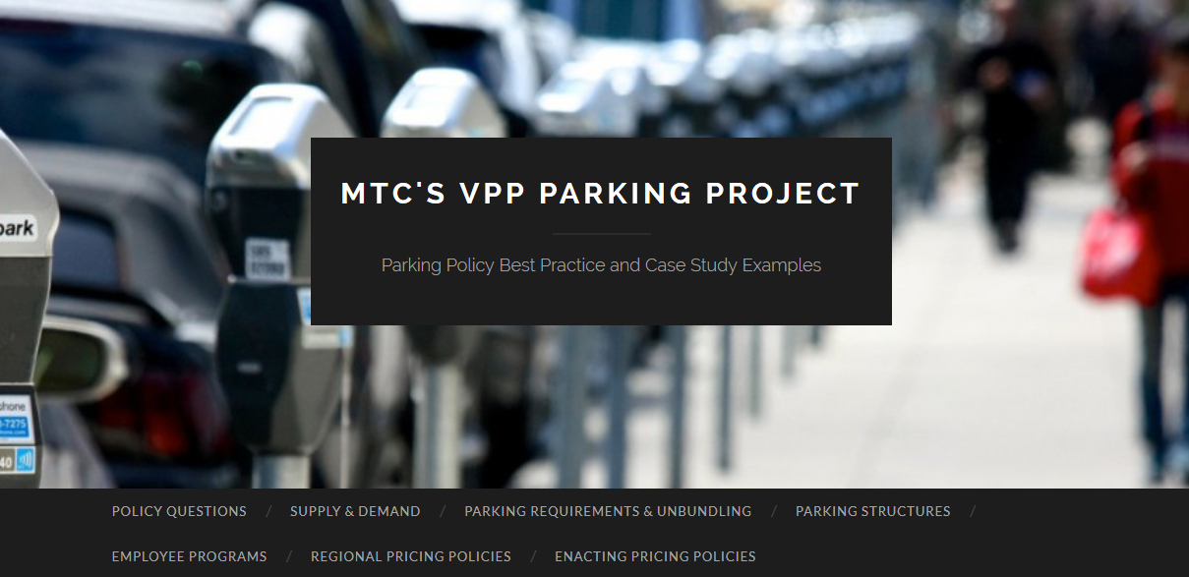
PART 2: POLICY QUESTIONS Also available at parkingpolicy.com

Slide 34
Policy Analysis - Importance
Analysis & Recommendations for local jurisdiction, transit agencies, and regional agencies
Provide a central source of best practices & applications throughout the Bay Area
Address key issues, defined by policy questions
Provide new research
Provide a forum for adding information

Slide 35
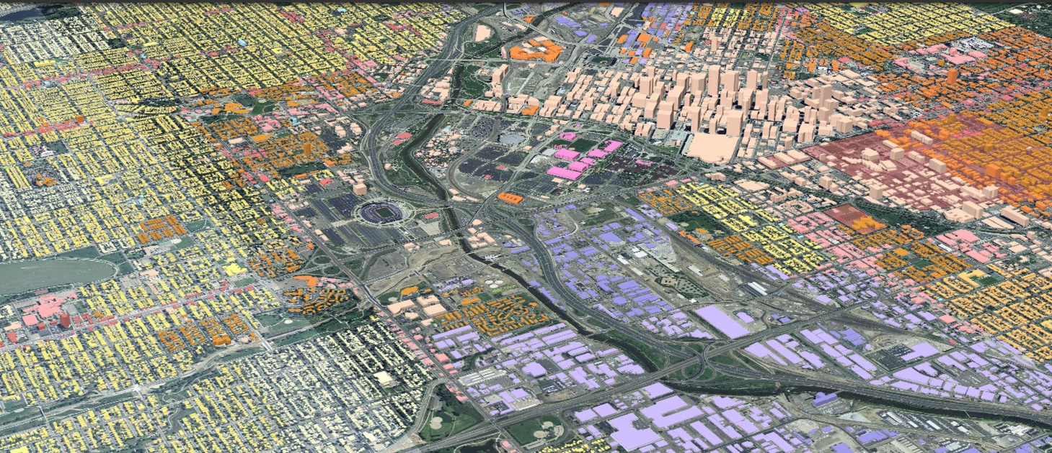
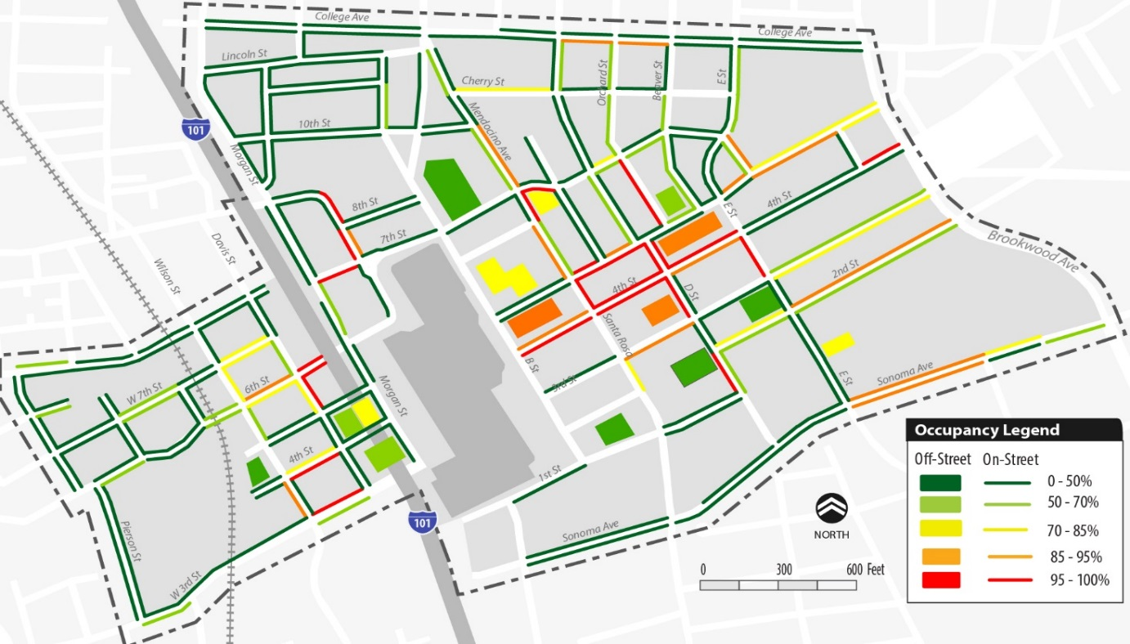
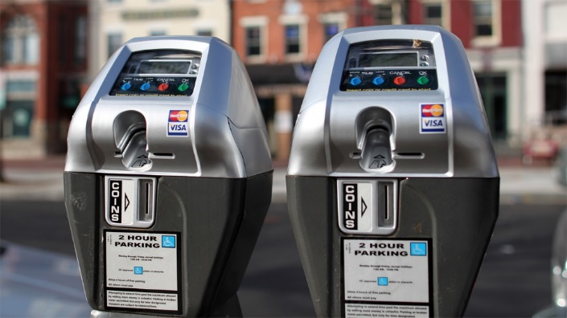
Policy Questions: Analysis Methods
Research of existing studies and practices from the region, country, and internationally
Best practices
Academic research
Case studies
2. Original analysis for this project
New data collection and existing data
GIS-based
Modeling
Input by Parking TAC, MTC staff, other professionals
Expert panel
MTC Commissioners’ input

Slide 36
Key Policy Questions Some of the 11 study questions have been combined for this discussion
Supply & Demand in the Bay Area
Where parking supply and demand do not match
Conditions for successful local parking pricing policies
Parking Requirements & Unbundling
Impact of reduced parking requirements
Demand for housing with lower amounts of parking
Impact of unbundling parking
Parking Structure Analysis
Planned or proposed parking structures
Employee Programs
Impact of a regional parking cash-out program
Regional Parking Pricing Policies
Considerations for an effective regional role
Enacting Pricing Policies
Conditions, perception and approaches to enact successful policies

Slide 37
#1 SUPPLY & DEMAND IN THE BAY AREA
Policy Questions
Where does local supply not match demand? What is the relationship to prices and other policies?
How common are the conditions that would lead to successful local parking pricing policies?

Slide 38
#1 SUPPLY & DEMAND IN THE BAY AREA
Method
Literature Review
Relationship between Supply, Demand, and Pricing
Price Elasticity of Demand
Parking Demand and Affordable Housing
Best Practices/Case Studies
New York City’s Variable Pricing Pilot
Berkeley’s goBerkeley Pilot
SFpark’s Demand-Based Pricing
Summary of new data from 25 cities:
Briefly summarize supply vs. usage for each location studied
High-level correlation with existing pricing/policies
Analyzing conditions, highlight pricing policies that could address performance goals

Slide 39
#1 SUPPLY & DEMAND IN THE BAY AREA
Potential Policy Actions
Regional support for additional analyses of local conditions (tied in with the new parking database)
Regional support for implementation of better parking policies using smart meters, information systems, etc.
Regional use of data and high-level recommendations to craft responsive policies to improve parking demand management.

Slide 40
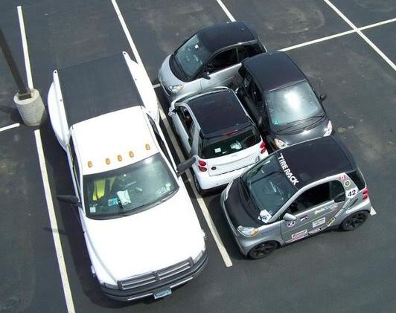
#2 REDUCED PARKING REQUIREMENTS & RESIDENTIAL DEMAND
Policy Questions
What would be the impact of reduced parking requirements?
How much demand exists for housing with lower amounts of parking?
What would be the impact of unbundling parking from rents on residential demand in urban areas?

Slide 41
#2 REDUCED PARKING REQUIREMENTS & RESIDENTIAL DEMAND
Best Practices/Case Studies
Reduced Parking Requirements in Santa Clara County
Reduced Parking Requirements and Housing Affordability
Reduced Parking Requirements in Los Angeles
Zoning Code Reform in Sacramento
Reducing Parking Requirements in Berkeley, CA
Elimination of Parking Minimums and Creation of Maximums in San Francisco
Use of King County’s Right Size Parking Calculator
Literature Review
Varying parking demand based on market segment: “Choosing Where We Live” (MTC, 2010)
Millennials and parking demand
Parking requirements for suburban multifamily Housing
Method
UrbanSim simulated how reducing or eliminated parking requirements in the regions Transit Priority Areas (TPAs) would affect how the region grows.
Additional Analysis:
GIS-based analysis of US Census data on car ownership in TPAs and/or surrounding BART and Caltrain Stations
GreenTRIP analysis

Slide 42
#2 REDUCED PARKING REQUIREMENTS & RESIDENTIAL DEMAND
Findings
Residential Growth & Non-residential Growth
parking requirements reduced by ½ (scenario 2)
parking requirements eliminated (scenario 3)
 | Residential Growth |  |  | Non-residential Growth
 | In TPA | Out TPA | Change from Baseline | In TPA | Out TPA | Change from Baseline
Scenario 1 (Baseline) | 73.2% | 26.8% | 0.0% | 60.0% | 40.0% | 0.0%
Scenario 2 | 75.4% | 24.6% | 2.2% | 63.1% | 36.9% | 3.1%
Scenario 3 | 76.7% | 23.3% | 3.5% | 65.8% | 34.2% | 5.8%
Movement of 3.5% of residential growth and 5.8% of non-residential growth into TPAs.

Slide 43
#2 REDUCED PARKING REQUIREMENTS & RESIDENTIAL DEMAND
Findings – Residential Demand & Unbundled Parking
There is unmet demand for TOD and housing with lower amounts of parking.
Households of renters and younger people (15-34) are much more likely to be car-free.
Households living in dense urban areas and close to high quality transit are much more likely to be car-free.
Percent of households with only one car have increased significantly in last decade
City | Description of Unbundling and related policies
San Francisco, CA | Unbundled parking with carsharing Apartments with the presence of carsharing and unbundled parking - 0.76 vehicles/unit
Clarendon,VA | Tiered payment system for unbundled parking: unbundled parking is $25/month for the first vehicle per unit, $75/month for the second, and $100/month for the third.
Bellevue, WA | Drive-alone commute rate decrease of 30 percent since unbundling policies enacted
Berkeley, CA | The Gaia Building - monthly parking price of $150/space Demand exists for only 20 spaces despite 42 available spaces (237 residents)
St. Louis, WA | TOD condo project - option to purchase a parking space for $18,000 Lowered costs for those who opt out of car-ownership. Given this choice 25% of condo buyers decided against the purchase of a parking space

Slide 44
#2 REDUCED PARKING REQUIREMENTS
Potential Policy Actions
Provide regional funding for subsidized carshare in locations that provide housing without parking or with very low parking requirements, and allow carshare pods to replace several required parking spaces as a VMT/GHG reduction measure
Include criteria of car free or low parking levels for housing in evaluation for regional funding programs
Require low parking minimums and unbundling of parking in PDAs within OBAG requirements as a condition of particular funds
Include requirements for unbundling and other smart growth parking policies in the regional principles for reviewing projects in the Cap and Trade AHSC Program

Slide 45
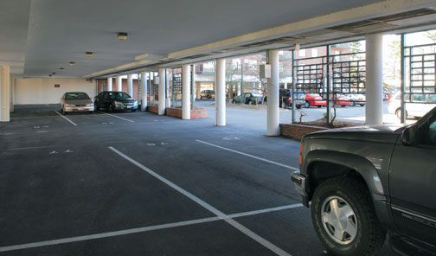
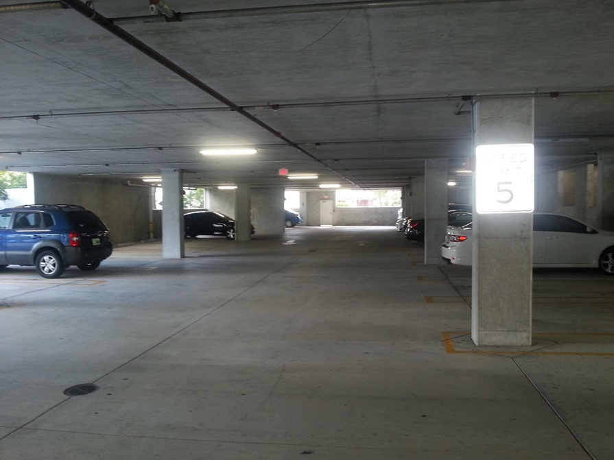
#3 PARKING STRUCTURE ANALYSIS
Policy Question
Could some planned or proposed parking structures be downsized?
Pricing policies
Alternative modes
Impacts on transit ridership
Impact on revenues and downtown retail

Slide 46
#3 PARKING STRUCTURE ANALYSIS
Best Practices
MTC’s Parking Structure Analysis
MTC, economic assessment of parking vs. housing at transit stations
Shared parking to reduce supply needs
Using taxes to affect private parking usage
Valet and off-site parking to reduce supply needs
Applications and Case Studies
Replacing parking with TOD at VTA light rail stations
Union City Park & Ride Pricing and Downsizing
Evaluating need for parking around Petaluma’s SMART stations
Valet Parking in Redwood City
Methods
MTC’s Travel Model One was used to look at the impact on BART ridership if the space used for parking was altered.

Slide 47
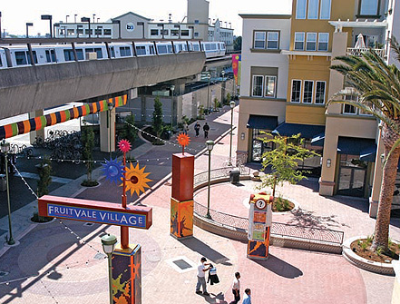
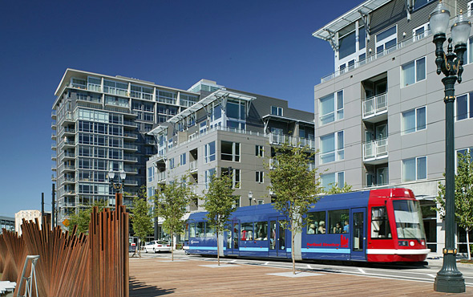
#3 PARKING STRUCTURE ANALYSIS
Findings
Travel Model One Analysis
BART ridership generated from 5 story housing is about half of that generated by parking – not including retail/office component.
Note: limited abilities of the model
BART Parking Structure Analysis:
6 stories of housing would replace ridership generated from a surface lot.
TOD produces more off-peak ridership, which is financially advantageous to BART, and works better within capacity constraints for peak direction/time.
TODs produce additional benefits in local retail/sales/property taxes and reduced vehicular traffic.

Slide 48
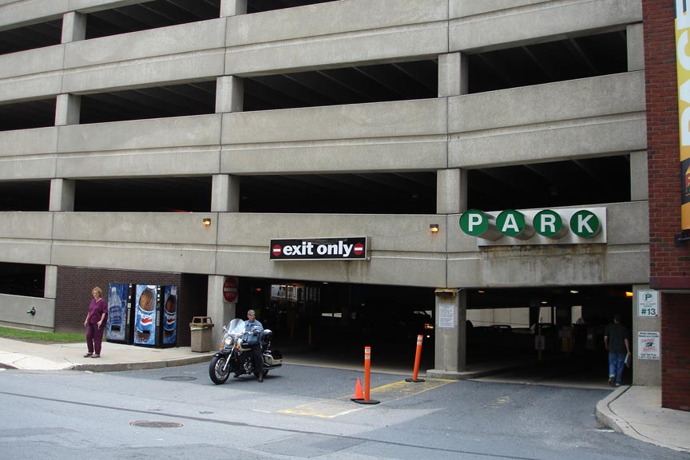
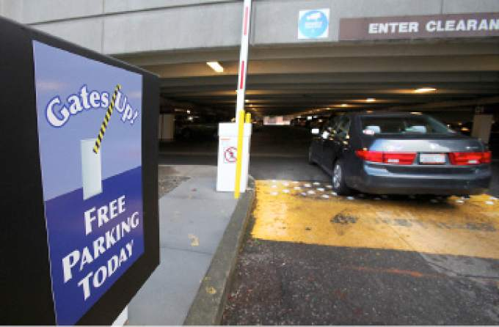
#3 PARKING STRUCTURE ANALYSIS
Potential Policy Actions
Regional policy actions include
Requiring appropriate planning and financial analysis prior to any regional funding of parking structures, including RM3 funding.
Local jurisdictions should
Incorporate study area vision when considering parking supply, including management alternatives w/multi-modal access.
Evaluate the cost of providing more parking and willingness of public to pay for un-subsidized parking.

Slide 49
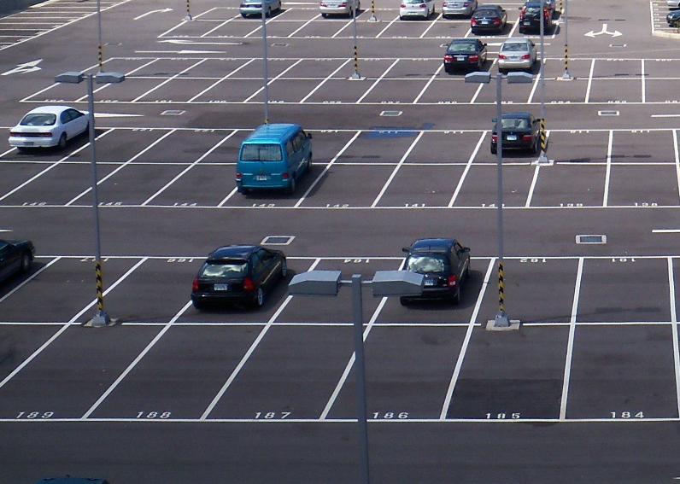

#4 EMPLOYEE PROGRAMS
Policy Question
What would be the impact on employment location and types, and on employees’ income of a regional parking cash-out program

Slide 50
#4 EMPLOYEE PROGRAMS
Best Practice Applications
California’s Parking Cash-out Law
Washington’s Commute Trip Reduction Law
Boulder Colorado Transit Passes
Genentech’s gRide Rewards program
Santa Monica’s Parking Cash-Out Law enforcement
Methods
Review of cash-out programs and commuter benefit programs that affect the price of parking. Application and review of potential within the Bay Area
Additional analysis:
Bay Area’s Commuter Benefits Ordinance (CBO)

Slide 51
#4 EMPLOYEE PROGRAMS
Findings
Studies have found significant decrease in drive-alone mode share to work when employees must pay to park.
A Bay Area survey found 77% of commuters drive alone when parking is free, whereas only 39% drive alone when they must pay for parking
Free parking overwhelms other factors in impacting mode choice; regardless of what other benefits are offered, free parking results in high drive alone rates
California enacted a parking cash-out law requiring employers with more than 50 employees (and certain additional qualifying characteristics) to offer a parking cash-out program.
17% decrease in drive-alone mode share for those who participated (Shoup, 1997).
A lack of enforcement and high employer exemption from the law has prevented many employers in participating.

Slide 52
#4 EMPLOYEE PROGRAMS
Potential Policy Actions
Require all employers that qualify to charge for parking, potentially coupled with transit subsidies.
Require enforcement of California’s parking cash out law in the Bay Area.
Eliminate minimum parking requirements for new office development.
Require employers to charge for parking in the renewed Bay Area Commuter Benefits Ordinance (CBO) and C/CAG trip reduction ordinance

Slide 53
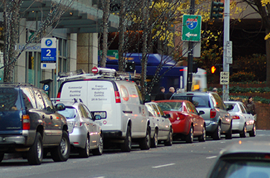
#5 REGIONAL POLICIES
Policy Questions
What are the most effective actions the regional agencies can take to support pricing parking policies?
Notes:
Regional – What are the most effective actions the regional agencies can take to support pricing parking policies?
Local – what are the conditions, public perception, and specific approaches to enact or enforce various priced parking policies?

Slide 54
#5 REGIONAL POLICIES
Methods
Applications & Best Practices
Parking Requirement Reform to Create a basis for Pricing
Repurposing Parking Supply to Create a Basis for Pricing
Parking Taxes in the City of Los Angeles
Partnerships with Entities Facing Parking Shortages
Climate Initiatives Program
PDA Planning and Plan Bay Area
MTC’s Resolution 3434 TOD Policy
The Bay Area Regional Prosperity Plan
CEQA reform with SB 743
The Commuter Benefits Program
TransitLink for TOD (T4T) Pilot Program
Policy Tools to address employee and resident dynamics
Analyses of potential regional actions, including brainstorming meetings with MTC staff.
MTC Commissioners will be briefed and consulted.
Public perceptions and responses are important – review recent local experiences with changes in parking pricing policies
Your thoughts regarding potential policies will be incorporated. Opportunity for your input will continue over the summer.
These questions will be a focus of the expert panel.

Slide 55
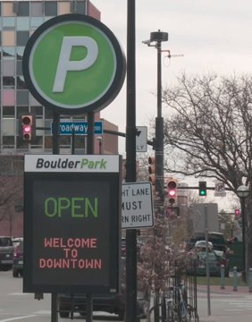
#5 REGIONAL POLICIES
Findings & Potential Regional Policy Actions
Funding parking assistance for regional database & tool development, planning and policy development
Funding local and regional (corridor) parking implementation strategies
Regional parking fee for congestion reduction and GHG reduction purposes.
Develop regional parking management system plan for local jurisdictions.
Regionally monitor local strategies, summarize, analyze and provide financial support.

Slide 56
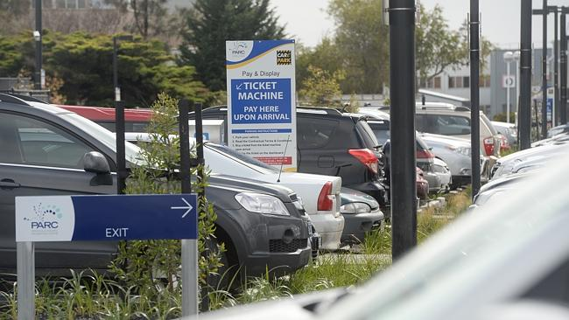
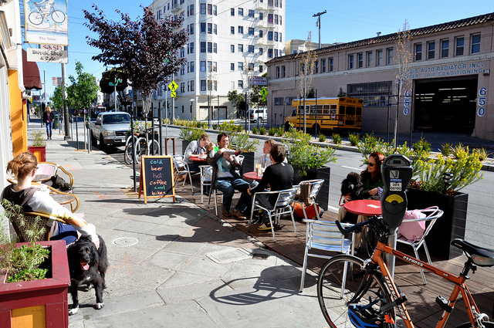
#6 ENACTING PRICING POLICIES
Policy Questions
What are the conditions, public perception, and specific approaches to enact or enforce various priced parking policies?

Slide 57
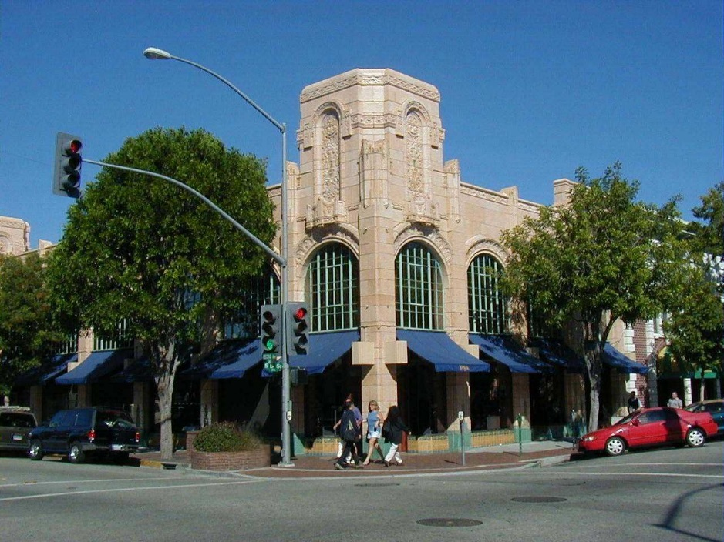
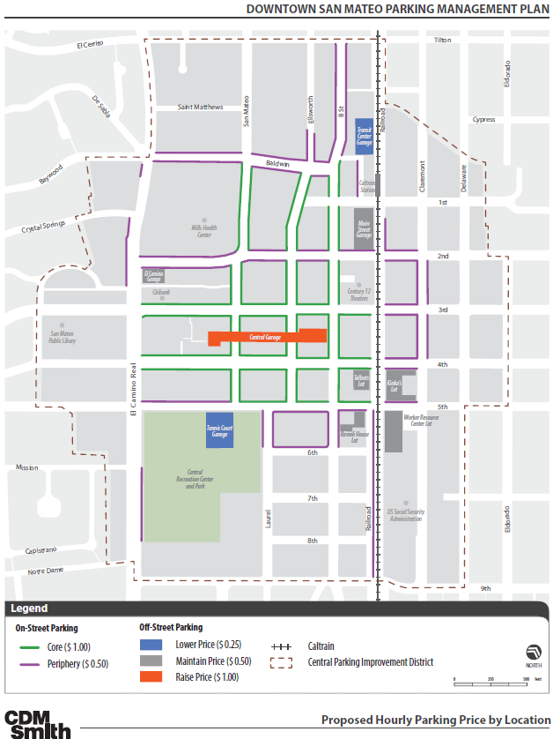
#6 ENACTING PRICING POLICIES
Findings – Public Perception
San Mateo
Local business and residential associations meetings
Community meetings
Public opinion survey
After explaining the concepts behind parking management, the public was generally supportive of market-based pricing.

Slide 58
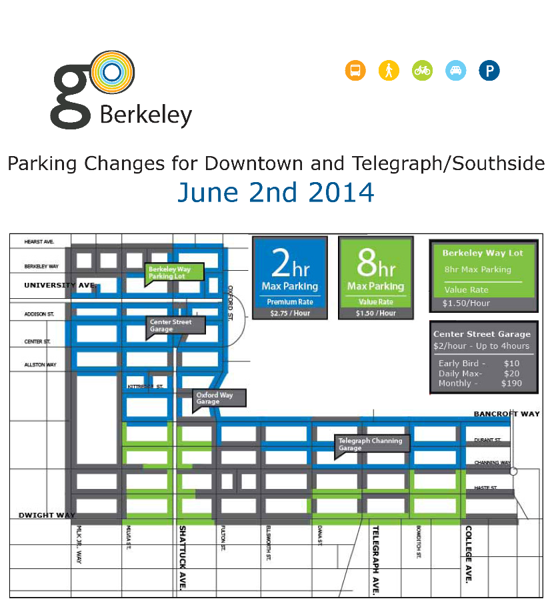
#6 ENACTING PRICING POLICIES
Findings – Public Perception
goBerkeley
Face-to-face interviews with local businesses
Community meetings in each pilot study area
Before and after intercept surveys
Ultimately, the public supported on-street price increases and changes in parking time limits where the was data to support it.
The business community supported this approach after understanding how it supports customers’ access to their businesses

Slide 59
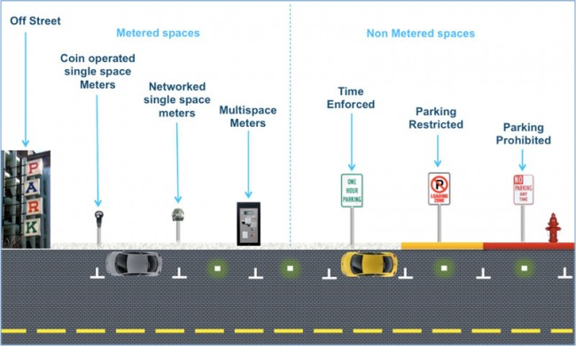
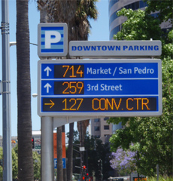
#6 ENACTING PRICING POLICIES
Findings – Specific Approaches and local cases reviewed
Components
Outreach & stakeholder support
Clear communication of benefits
Re-investing revenues back into the community
Tax or charge impact fees to private facilities
Increase enforcement

Slide 60
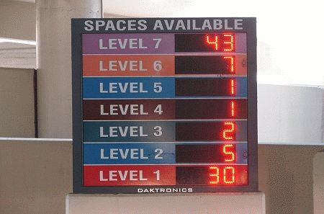

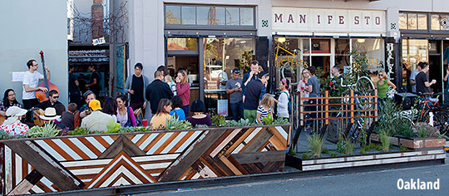
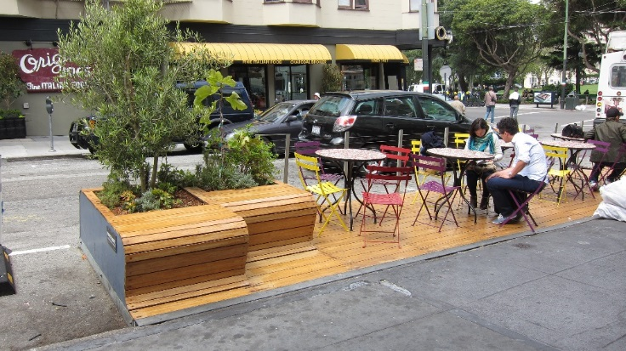
#6 ENACTING PRICING POLICIES
Parking Policy Implementation Plans
Funding for studies & capital equipment.
Parking Benefit Districts as a mechanism to provide local support for pricing through reinvestment.
Reduce/eliminate parking minimums
Tiered pricing to shift demand to underutilized facilities.
Variable pricing
Taxes and impact fees on private facilities so that cost is passed on to users
Actively enforce current restrictions

Slide 61
Summary of Policy Issues
Where does local supply not match demand and at what price? How common are the conditions that would lead to successful local parking pricing policies?
Regional support
Additional analyses of local conditions (with the new parking database)
Implementation of better policies
Use of data and high-level recommendations to craft responsive policies to improve parking demand management.

Slide 62
Summary of Policy Issues
How can we support reduced parking requirements and unbundling
Provide regional funding for subsidized carshare in locations that provide housing without parking or with very low parking requirements, and allow carshare pods to replace several required parking spaces as a VMT/GHG reduction measure
Include criteria of car free or low parking levels for housing in evaluation for regional funding programs
Require low parking minimums and unbundling of parking in PDAs within OBAG requirements as a condition of particular funds
Include requirements for unbundling and other smart growth parking policies in the regional principles for reviewing projects in the Cap and Trade AHSC Program

Slide 63
Summary of Policy Issues
Could some planned or proposed parking structures be downsized?
Regional policy actions include
Requiring appropriate multi-modal planning and financial analysis prior to any regional funding of parking structures, including RM3 funding.
Local jurisdictions should
Incorporate study area vision when considering parking supply, including management alternatives w/multi-modal access.
Evaluate the cost of providing more parking and willingness of public to pay for un-subsidized parking.

Slide 64
Summary of Policy Issues
What would be the impact on employment location and types, and on employees’ income of a regional parking cash-out program?
Require all employers to charge for parking, potentially coupled with transit subsidies.
Require enforcement of California’s parking cash out law in the Bay Area.
Eliminate minimum parking requirements for new office development.
Require employers to charge for parking in the renewed Bay Area Commuter Benefits Ordinance (CBO) and C/CAG trip reduction ordinance

Slide 65
Summary of Policy Issues
What are the most effective actions the regional agencies can take to support pricing parking policies?
Funding parking assistance for regional database & tool development, planning and policy development
Funding local and regional (corridor) parking implementation strategies
Regional parking fee for congestion reduction and GHG reduction purposes.
Develop regional parking management system plan for local jurisdictions.
Regionally monitor local strategies, summarize, analyze and provide financial support.

Slide 66
Summary of Policy Issues
What are the conditions, public perception, and specific approaches to enact or enforce various priced parking policies?
Funding for studies & capital equipment.
Parking Benefit Districts as a mechanism to provide local support for pricing through reinvestment.
Reduce / eliminate parking minimums
Tiered pricing to shift demand to underutilized facilities.
Variable pricing
Taxes and impact fees on private facilities so that cost is passed on to users
Actively enforce current restrictions

Slide 67
Policy Question Discussion

Slide 68
Next Steps
Updated work and information is posted on-line for your review and comment at
parkingpolicy.com
MTC Planning Committee - review of study findings and policy options: May 8
Expert Panel- refine policy recommendations for MTC actions: June 2
MTC Planning Committee - consideration of regional policy recommendations: Oct 9

